Slide 1

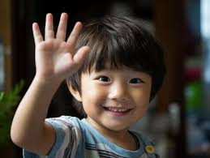

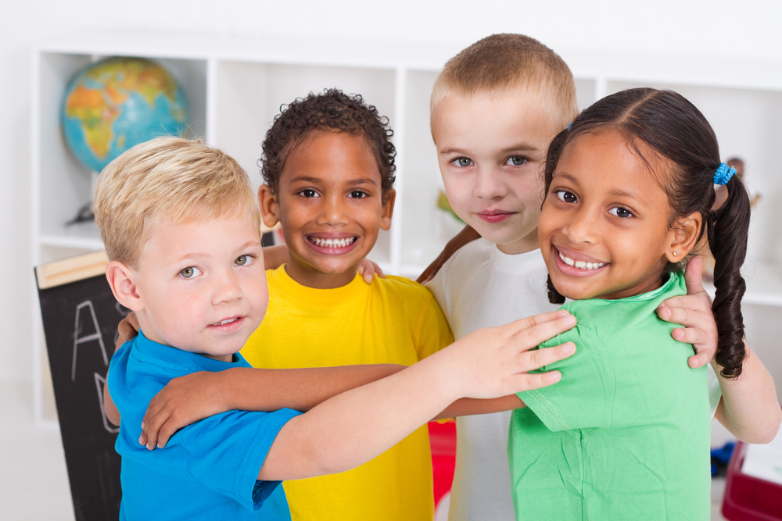
Arrival Time
Family Grouping

Slide 2

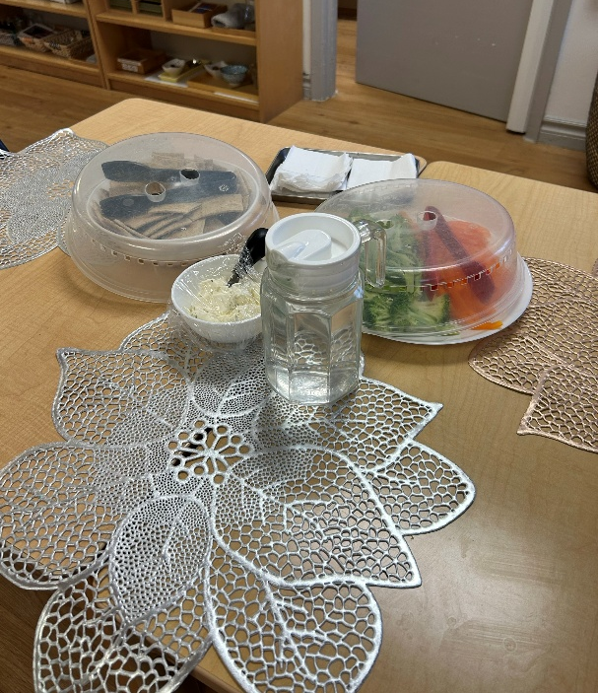

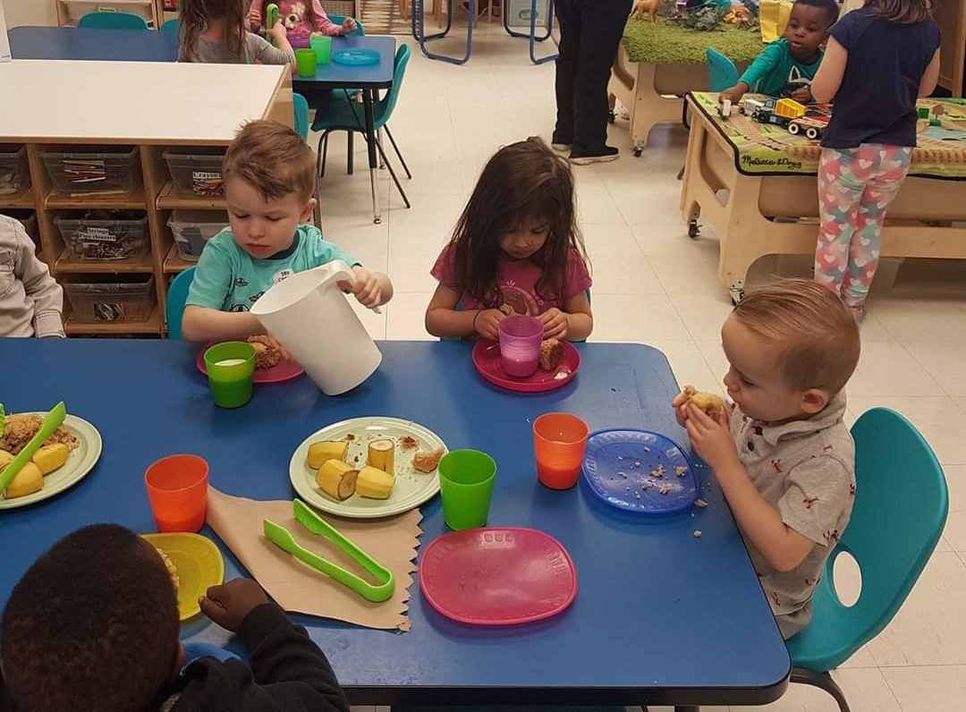
Open Snack
Open Snack

Slide 3




Arrival
Time
Family
Grouping
Open Snack
Open Snack

Slide 4

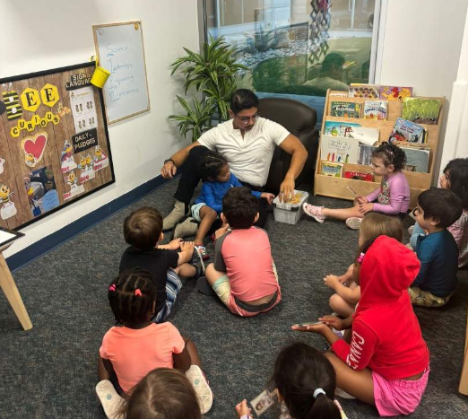

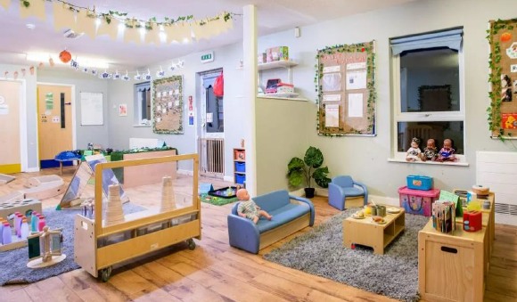
Gathering Circle
BeeCurious Open
Learning

Slide 5
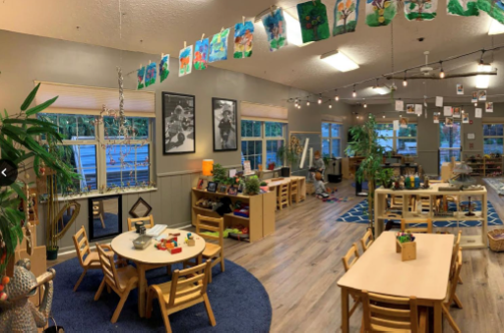

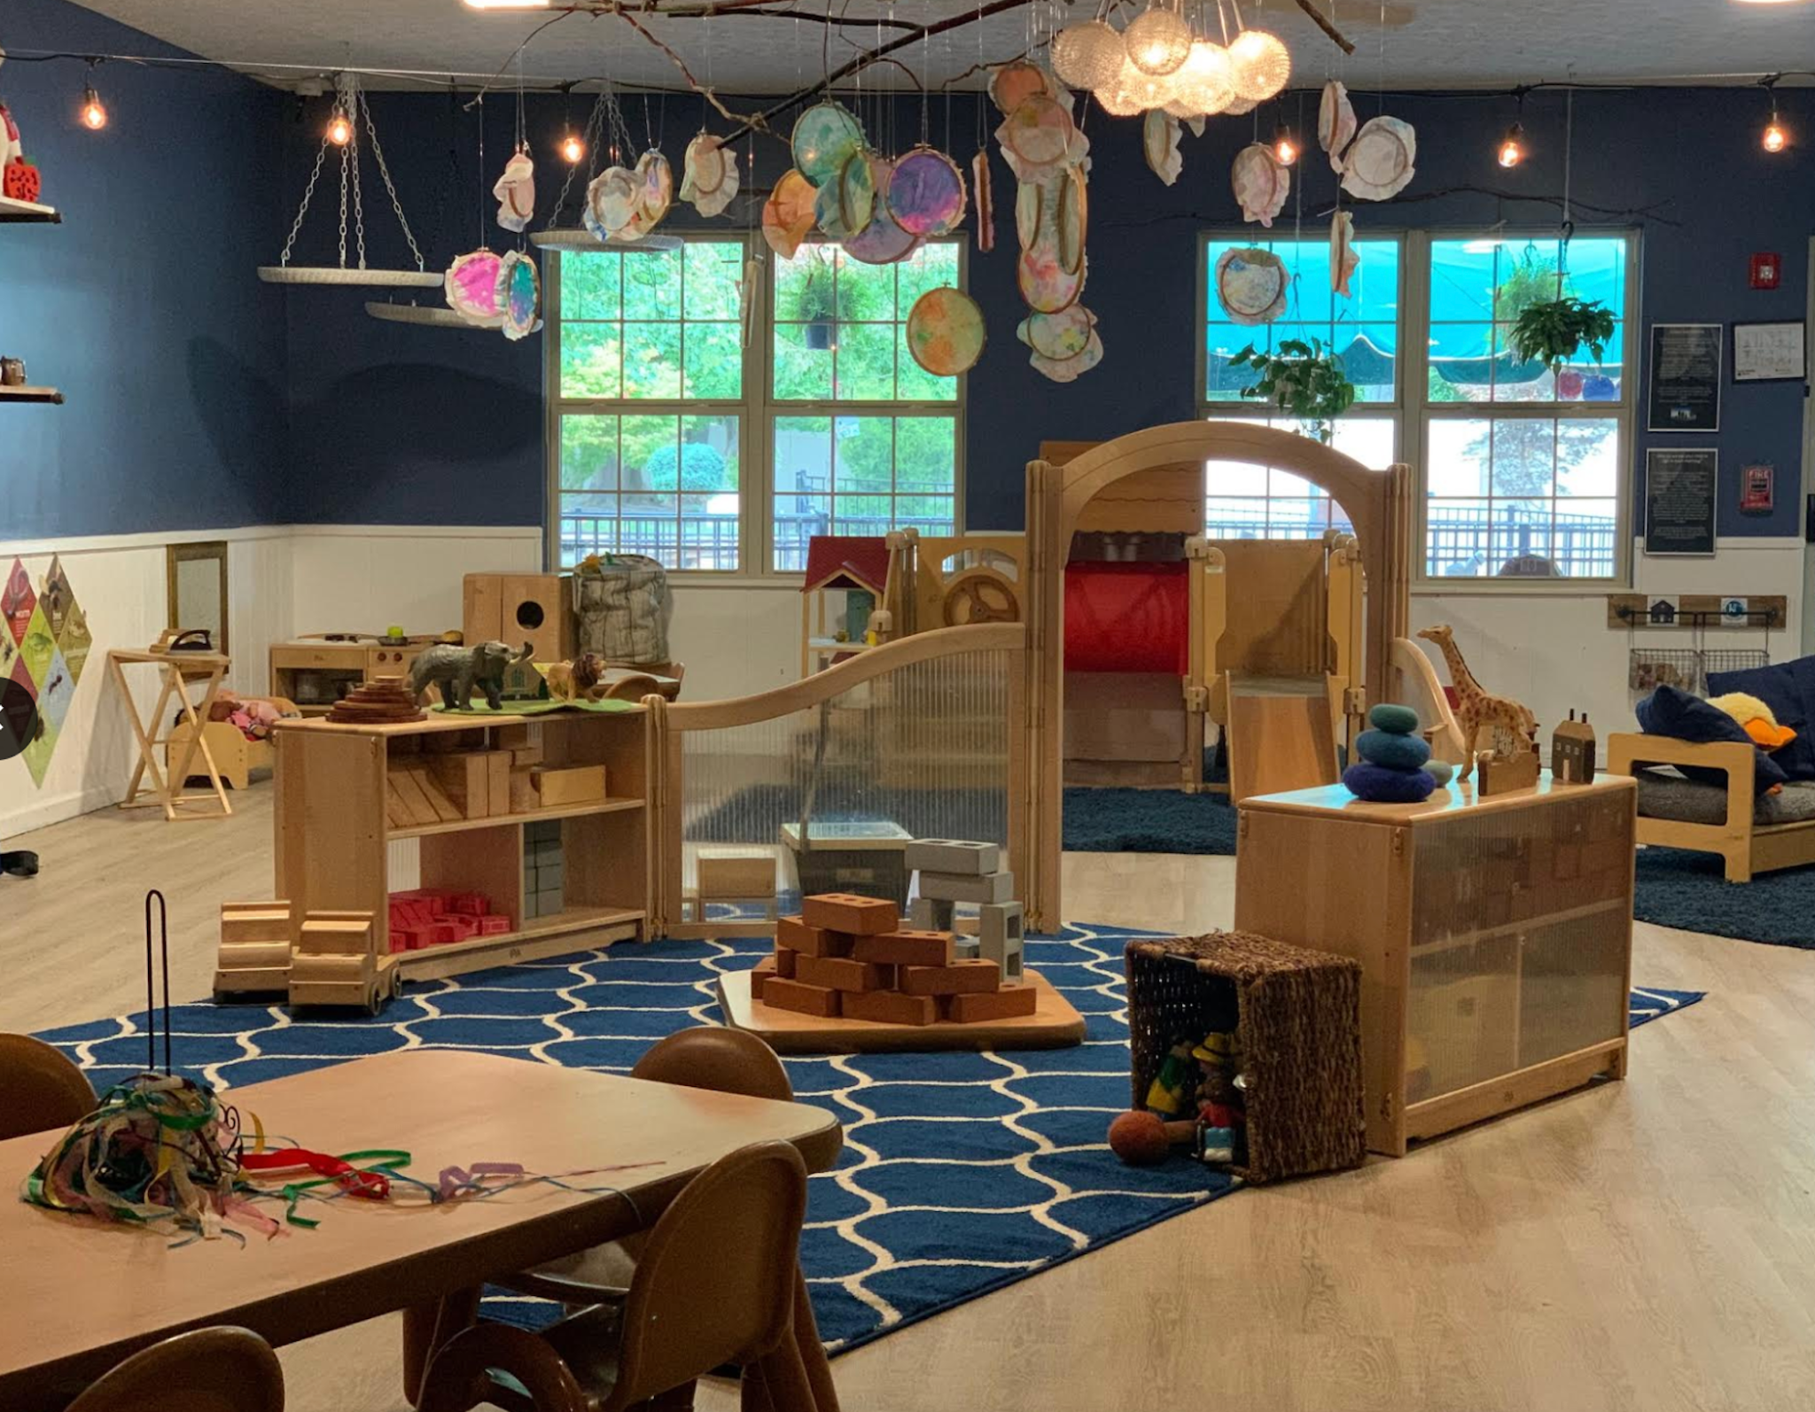
BeeCurious Open Learning
BeeCurious Open Learning

Slide 6
Gathering
Circle
BeeCurious
Open Learning
BeeCurious
Open Learning
BeeCurious
Open Learning

Slide 7

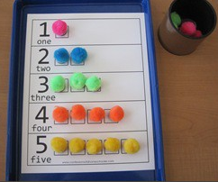

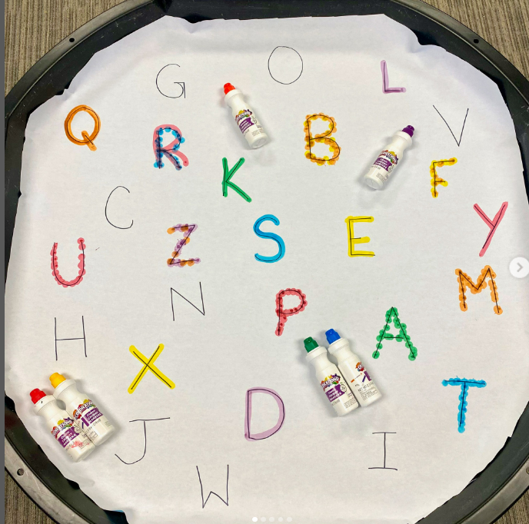
Buzz Math
Language and Literacy

Slide 8
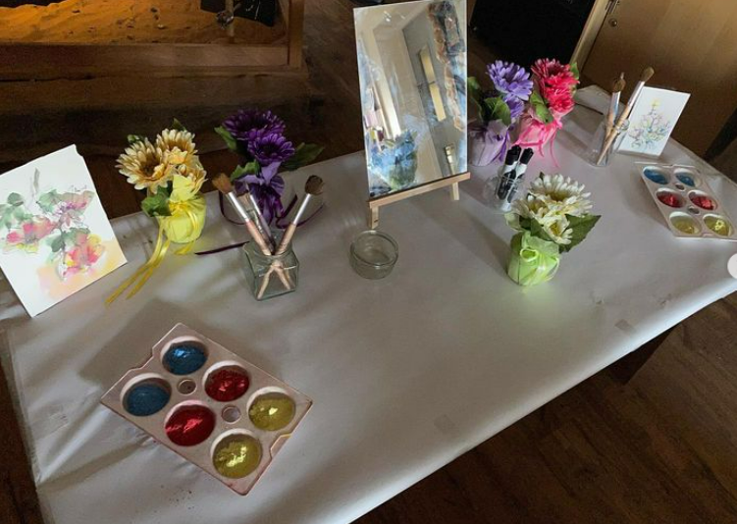

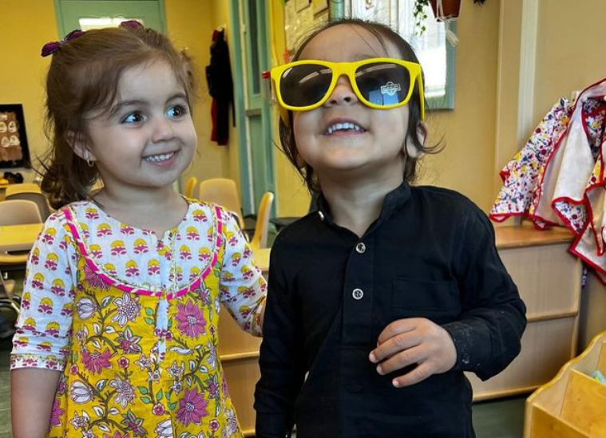
Creative Discovery
Building Connections

Slide 9
Buzz
Math
Language &
Literacy
Creative
Discovery
Building
Connections

Slide 10

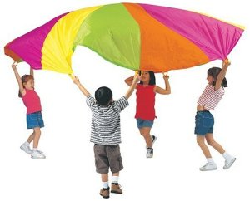

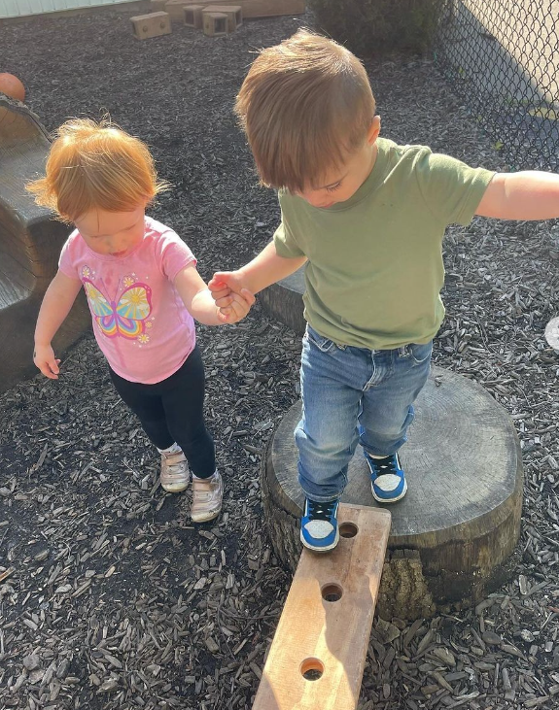
Physical Literacy
WeeMove

Slide 11

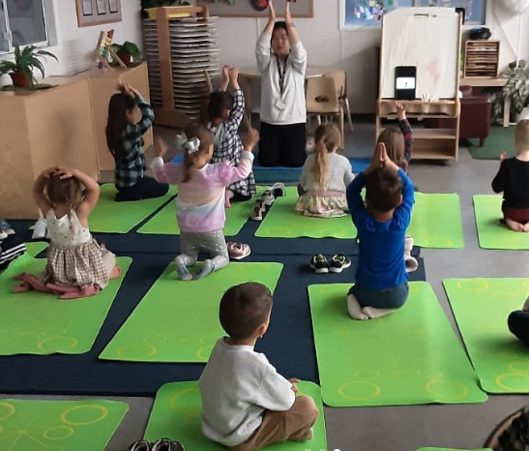

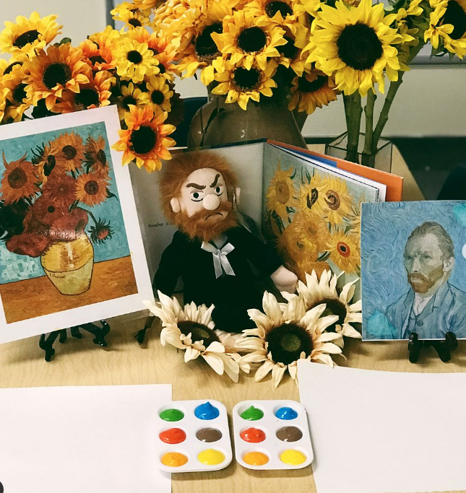
Yoga
Artist of the Month
@tinkerwonderplay
@our_curious_journey

Slide 12
Physical
Literacy
WeeMove
Yoga
Artist of
the Month

Slide 13

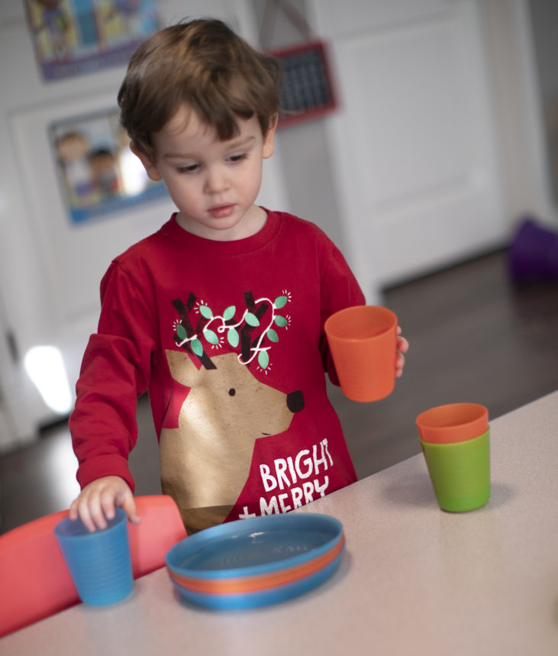

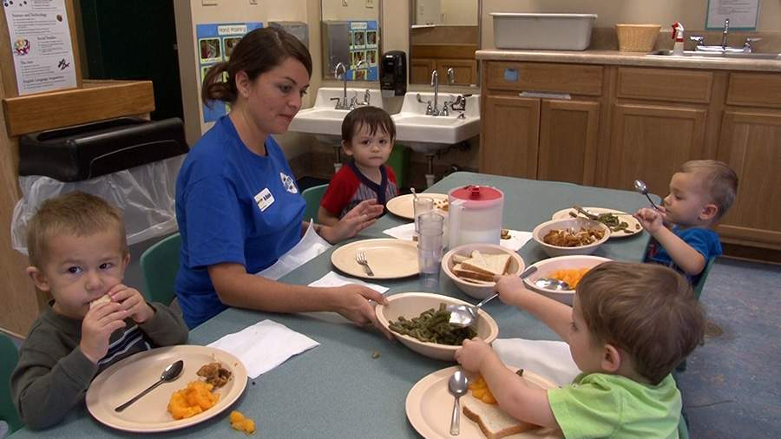
Lunch Set Up
Lunch

Slide 14

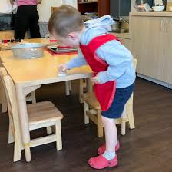

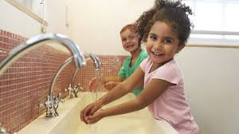
Lunch Clean Up
Wash Hands

Slide 15
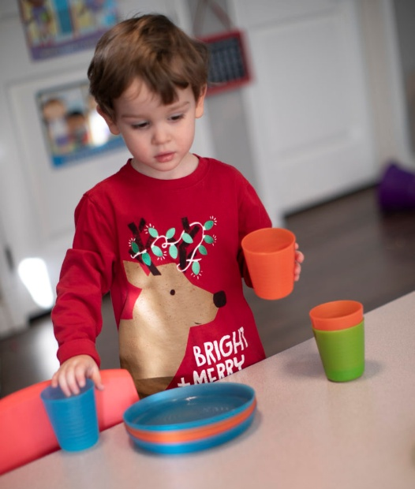
Lunch Set
Up
Lunch
Time
Lunch Clean
Up
Wash
Hands

Slide 16

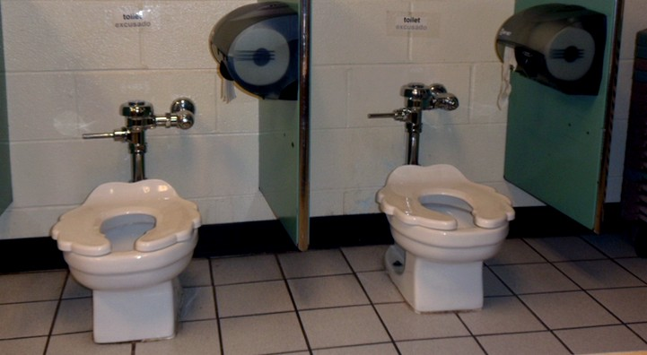
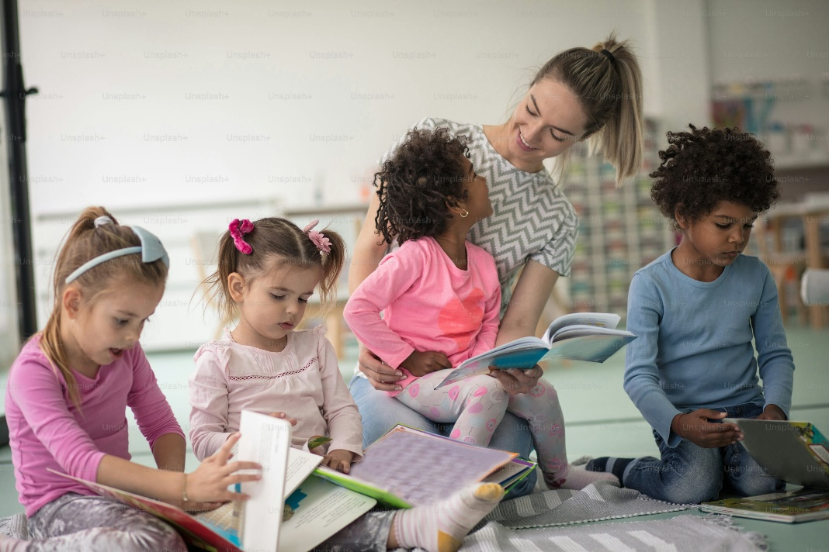
Washroom
Quiet Reading

Slide 17

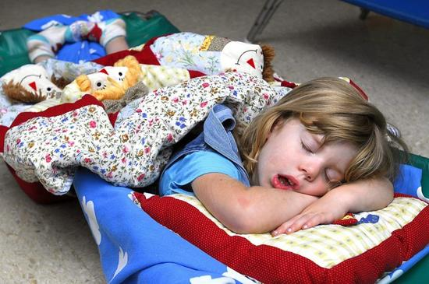

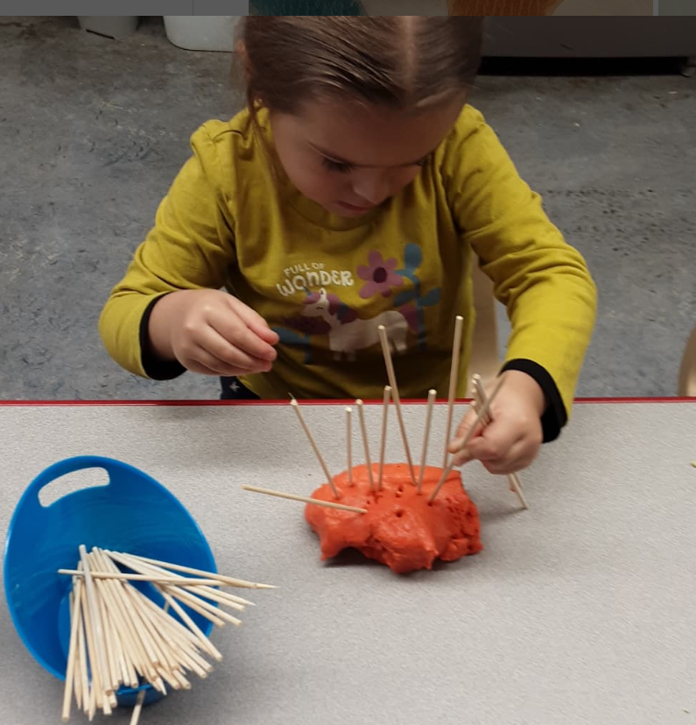
Rest Time
Quiet Activities

Slide 18

Washroom
Time
Quiet
Reading
Rest
Time
Quiet
Activities

Slide 19

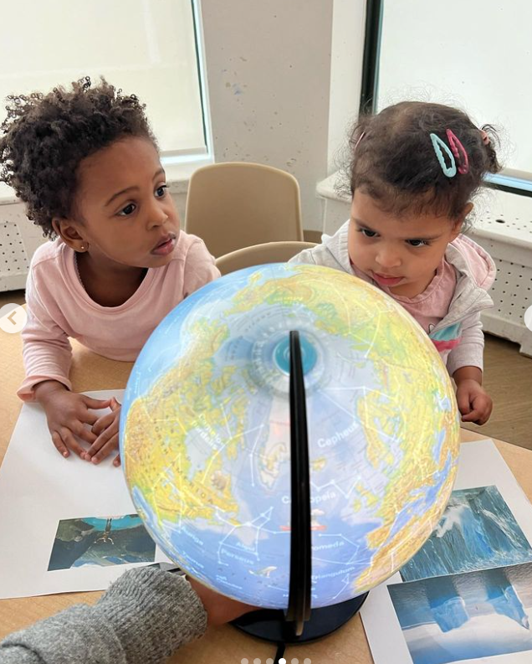

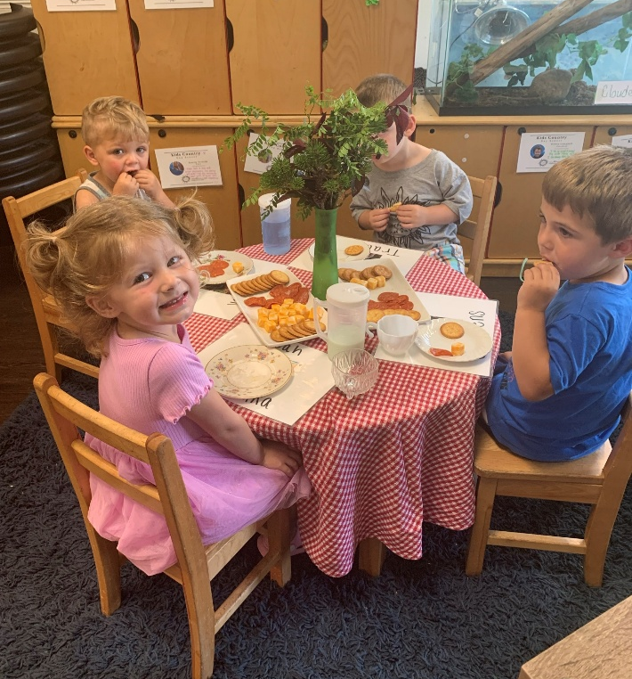
Enrichment Time
Open Snack

Slide 20

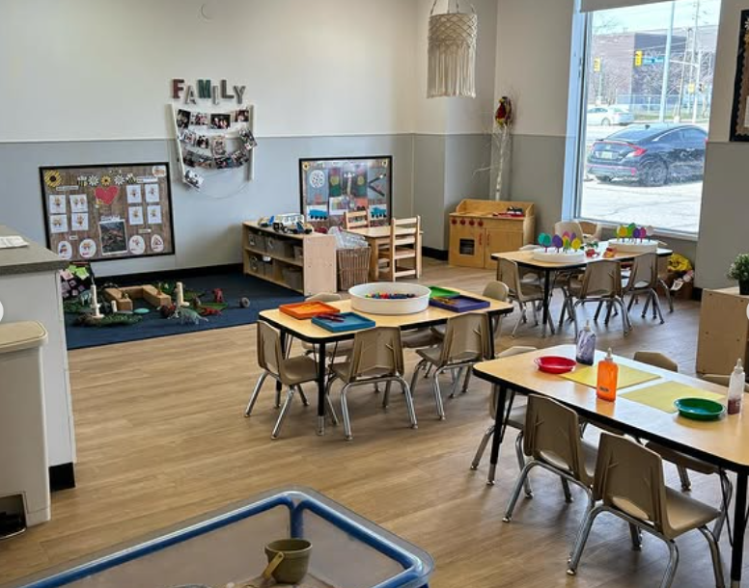
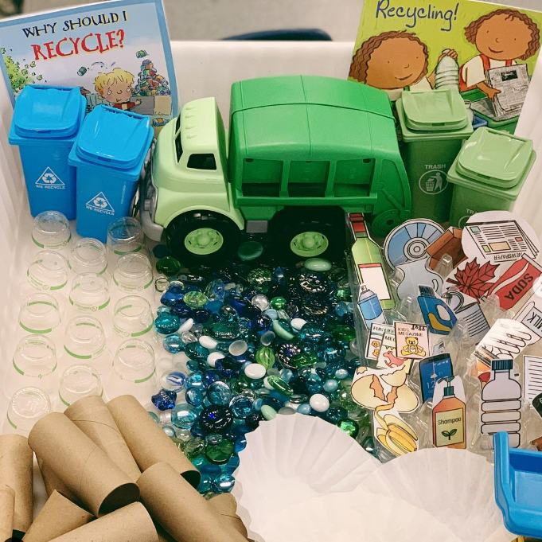
BeeCurious Open
Learning
Environmental Stewardship

Slide 21
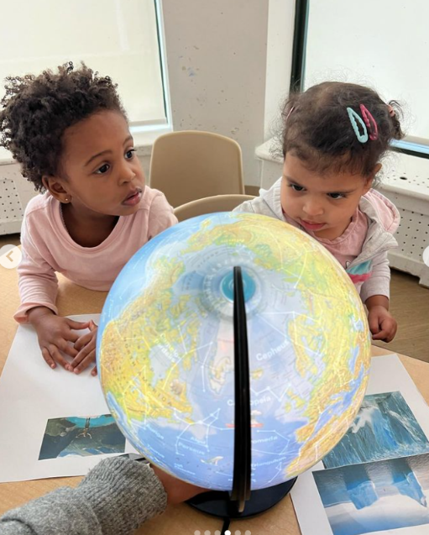
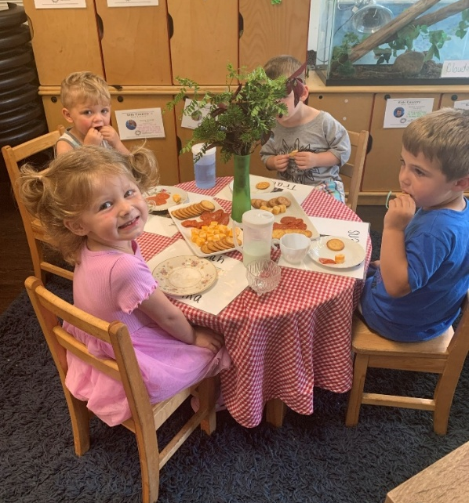
Enrichment
Time
Open
Snack
BeeCurious
Open Learning
Environmental
Stewardship

Slide 22

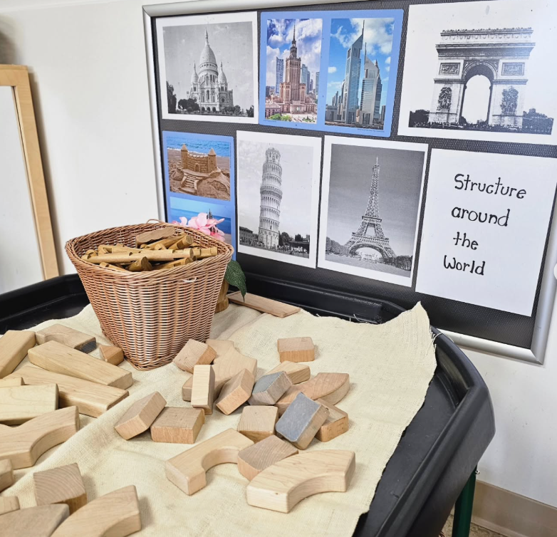

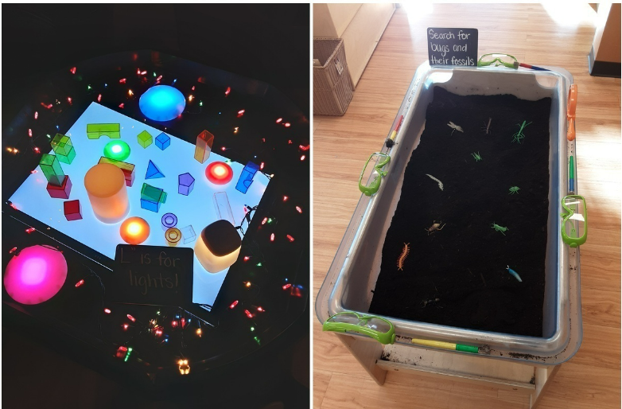
Global Citizenship
STEM

Slide 23

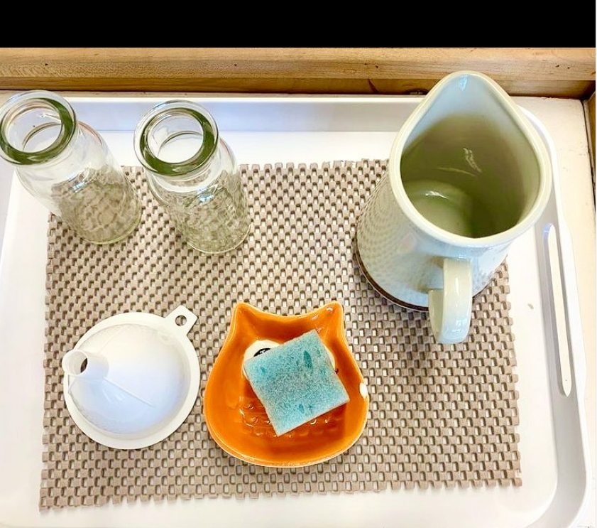

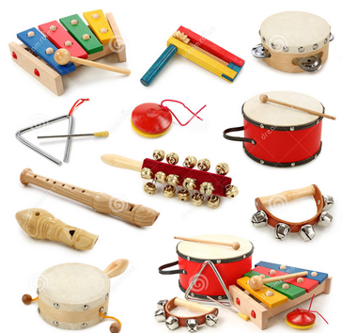
Essential Skills
@ourmontessorilife
Music and Movement

Slide 24
Global
Citizenship
STEM
Essential
Skills
Music &
Movement

Slide 25

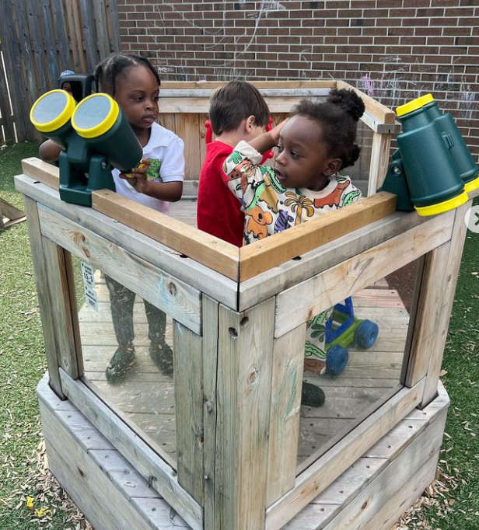
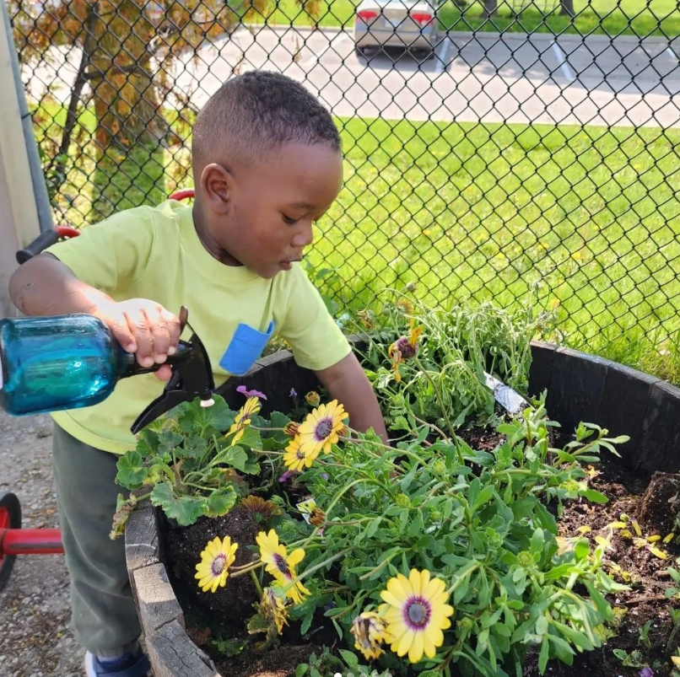
Outside Time
Outside Time

Slide 26

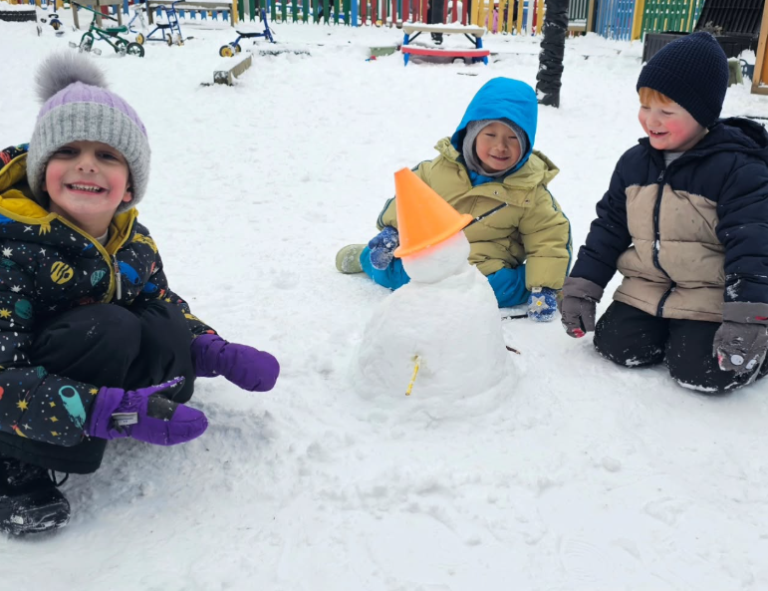
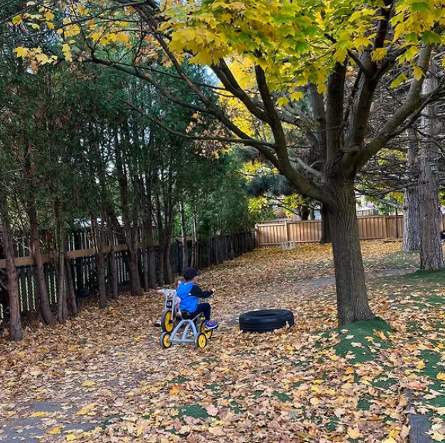
Outside Time
Outside Time

Slide 27

Outside
Time
Outside
Time
Outside
Time
Outside
Time

Slide 28

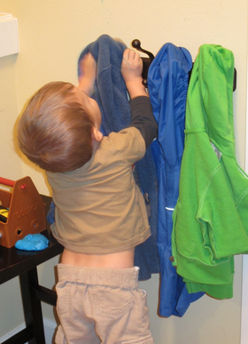
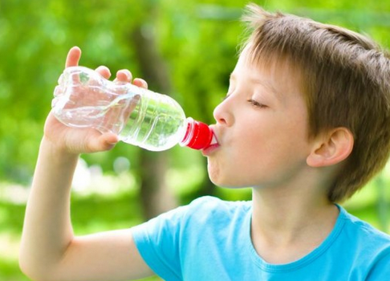
Coats
Water Bottles

Slide 29

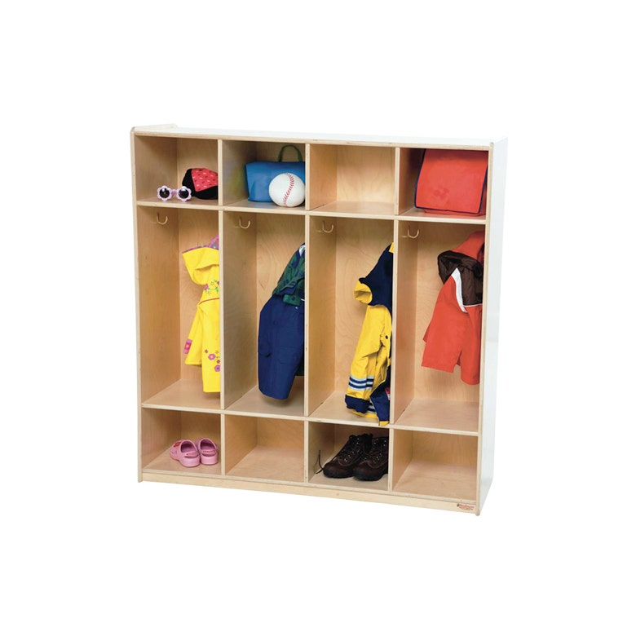
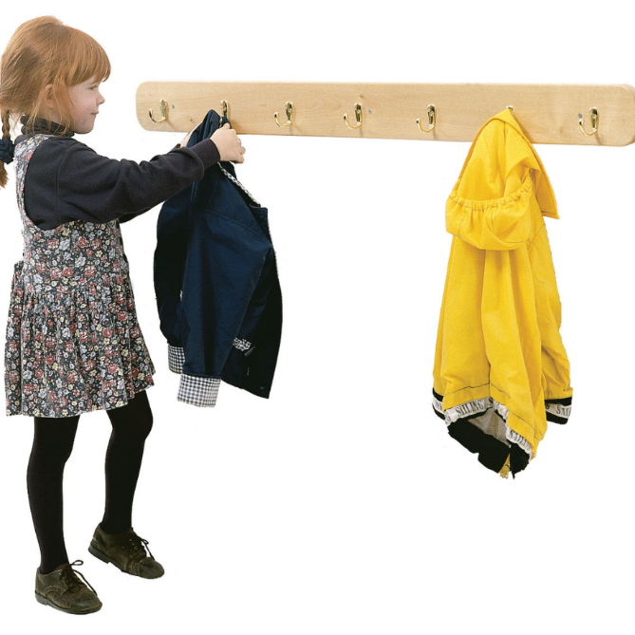
Cubbies
Hooks
https://themontessoriroom.com

Slide 30

Coats
Water
Bottles
Cubbies
Hooks

Slide 31
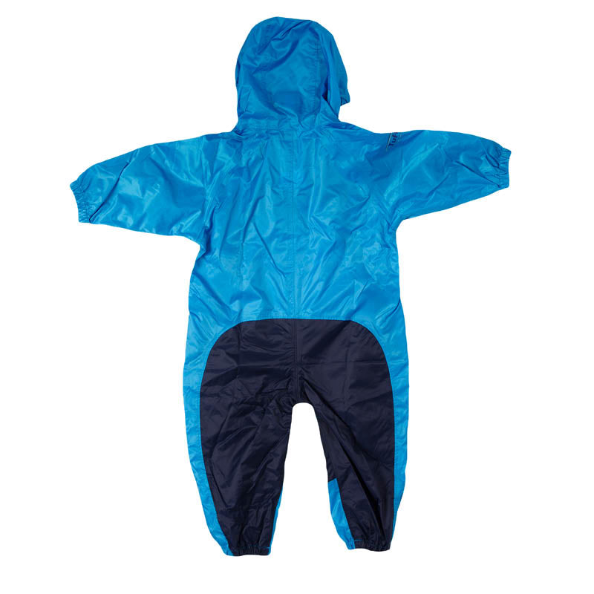
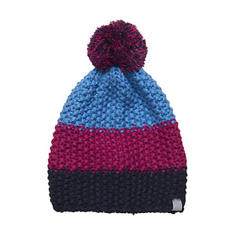
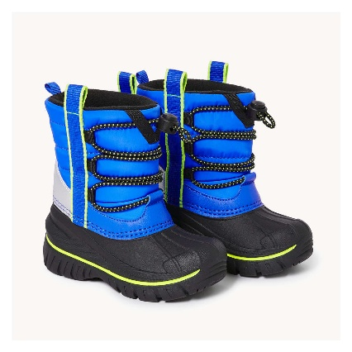
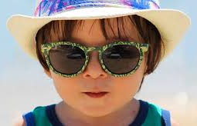

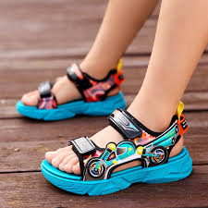
Outdoor Gear
Outdoor Gear

Slide 32


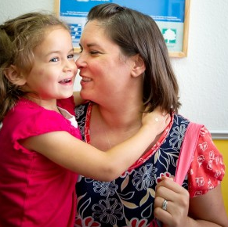
Arrival
Pick Up Time

Slide 33


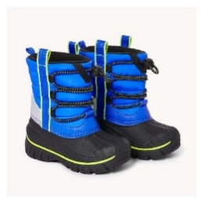
Outdoor
Gear
Outdoor
Gear
Arrival
Pick Up
Time

